Slide 1
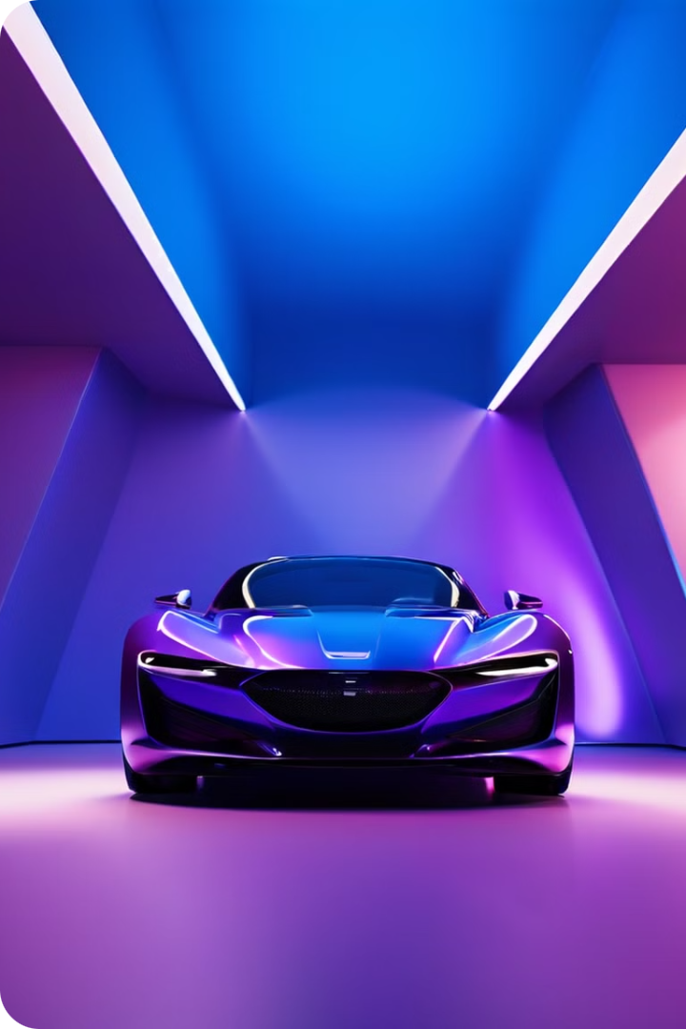


by Muhmmad Ietazaz Aslam
Automobile Price Prediction using Advanced Machine Learning Techniques
Data Analysis and Visualization
Muhmmad Ietazaz Aslam
1

Slide 2
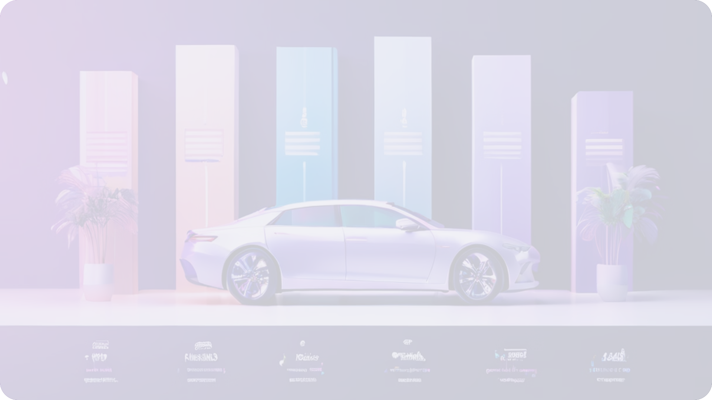

Agenda:
Objectives
Exploratory Data Analysis
Data Preprocessing
Machine Learning Models
Models Evaluation & Performance
Visualization
Best Performing Model
Implications & Future Work
2

Slide 3
Objectives:
To develop a comprehensive understanding of predicting car prices.
Preprocess the dataset to handle missing values, outliers, and categorical variables.
To implement various machine learning models, including Linear Regression, Support Vector Machine (SVM), Logistic Regression, K-Nearest Neighbors (KNN), Decision Tree, and Bayesian Classifier.
Evaluate and compare the performances of these models to determine the most accurate for predicting car prices.
3

Slide 4
\
Dataset:
Source: Kaggle.
Collected data of over 90,000 cars (from 1970-2024).
Attributes: model, price, transmission, mileage, fuel type, tax, mpg, engine size, and manufacturer
4

Slide 5
Exploratory Data Analysis
1
Descriptive Statistics
2
Data Visualization
3
Correlation Analysis
Gained insights into the dataset's structure and characteristics through statistical analysis.
Utilized visualizations to uncover relationships between variables and identify trends.
Examined the interdependence of features to inform feature selection for modeling.
5

Slide 6
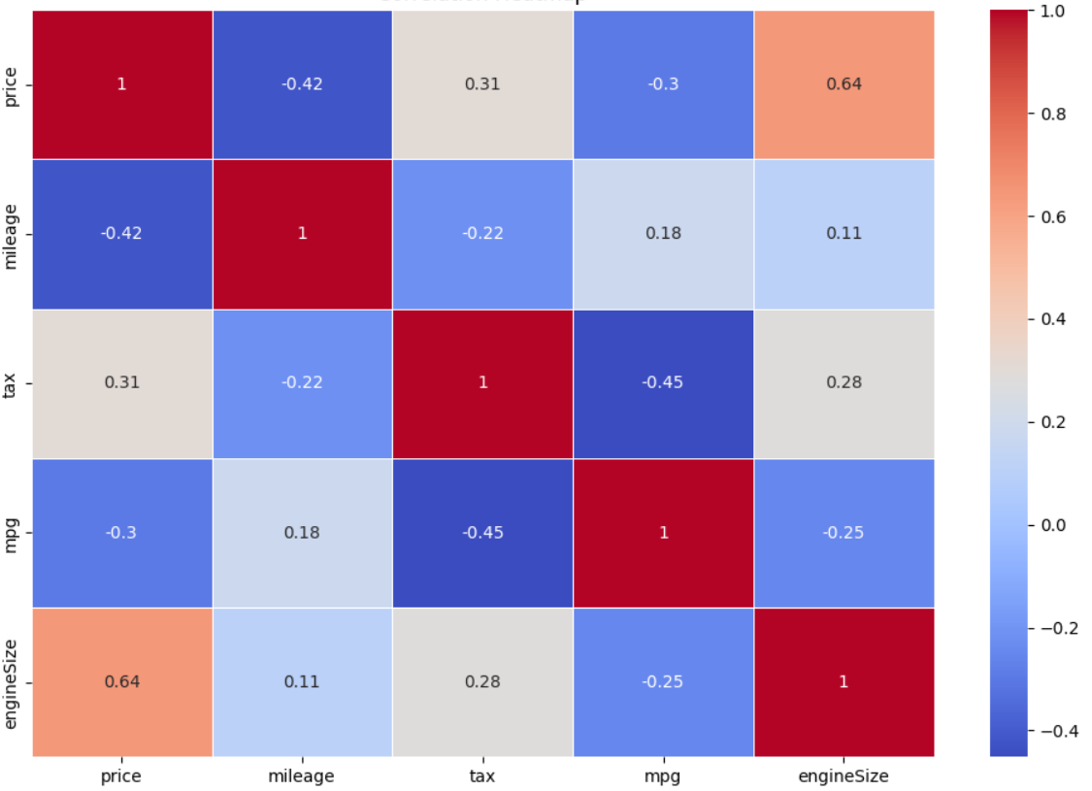
Exploratory Data Analysis
Data Visualization
3
Correlation Analysis
Correlation Analysis:
Utilized visualizations to uncover relationships between variables and identify trends.
Examined the interdependence of features to inform feature selection for modeling.
6

Slide 7
Data Preprocessing
Missing Values
Outlier Removal
Feature Engineering
No missing values
Identified and removed outliers using the Z-score method to prevent skewing the models.
Encoded (one-hot encoding) categorical variables for compatibility with models.
7

Slide 8
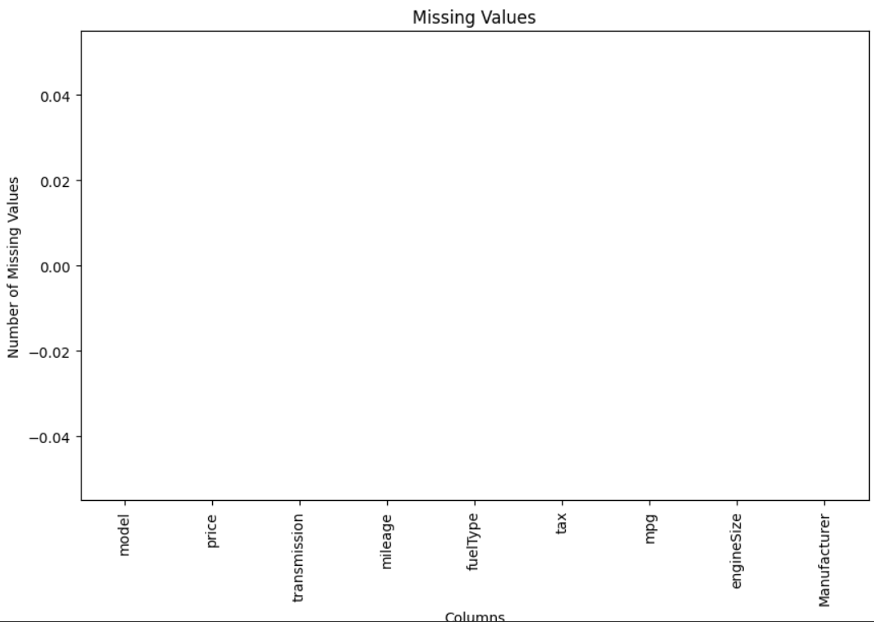
Data Preprocessing
Missing Values:
Data Visualization
3
Correlation Analysis
No missing values.
Utilized visualizations to uncover relationships between variables and identify trends.
Examined the interdependence of features to inform feature selection for modeling.
8

Slide 9
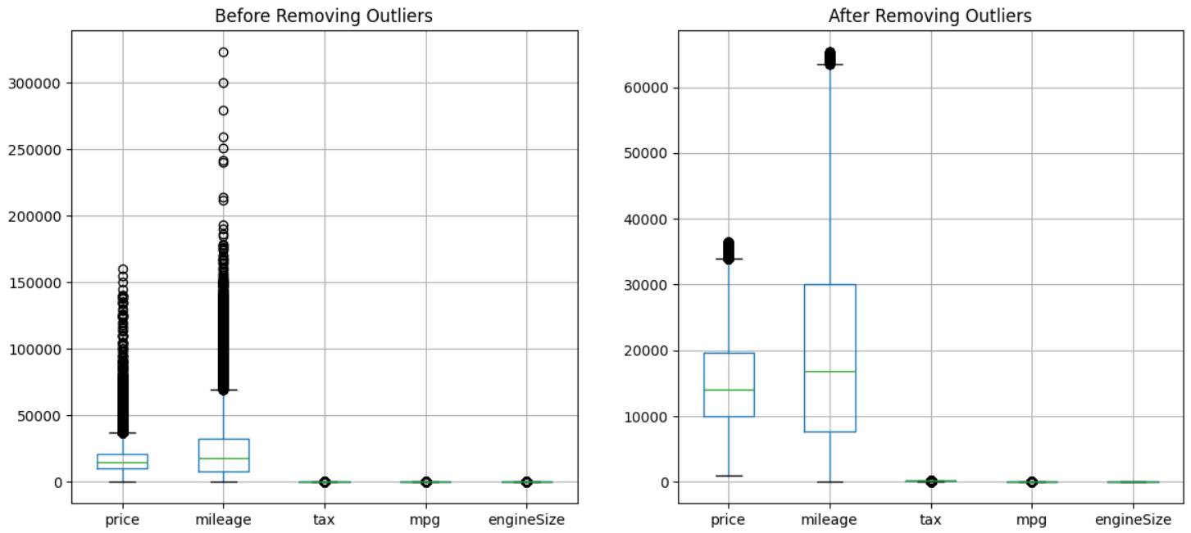
Data Preprocessing
1
Outliers:
Data Visualization
3
Correlation Analysis
Z-Score Method
Z-Score greater than 3 were considered as outliers.
Utilized visualizations to uncover relationships between variables and identify trends.
Examined the interdependence of features to inform feature selection for modeling.
9

Slide 10
Machine Learning Models
Multivariate Regression
Support Vector Machine
Logistic Regression
Established a baseline performance for predicting car prices.
Evaluated the model's ability to handle non-linear relationships and high-dimensional data.
Assessed the model's performance in binary classification tasks.
10

Slide 11
Machine Learning Models
K-Nearest Neighbors (KNN)
Bayesian Classifier
Decision Tree
Established a baseline performance for predicting car prices.
Evaluated the model's ability to handle non-linear relationships and high-dimensional data.
Assessed the model's performance in binary classification tasks.
11

Slide 12
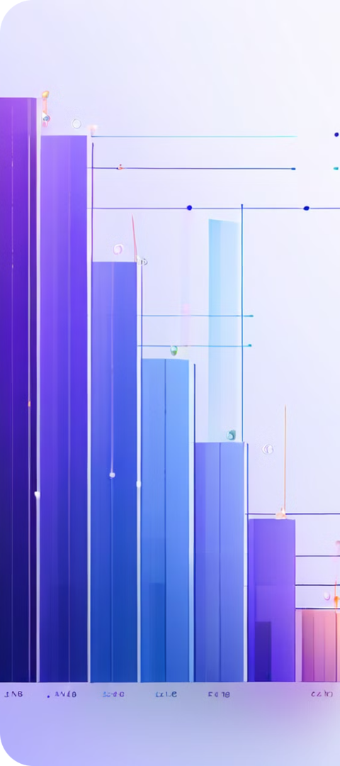
Model Evaluation Measures
1
MSE
Assessed the models' predictive accuracy using Mean Squared Error.
2
R-squared
Evaluated the models' ability to explain the variance in the target variable.
3
Cross-Validation
Ensured the models' generalizability to new data through techniques like k-fold cross-validation.
12

Slide 13
Models Evaluation
Model | Mean Squared Error (MSE) | R-Squared
Multivariate Regression | 34072405.85813499 | 0.6531577175160103
Decision Tree | 22033791.70165864 | 0.7757055771934742
Support Vector Machine (SVM) | 66816207.61277331 | 0.31984004734419624
Logistic Regression | 34254795.72582797 | 0.6513010679364067
K-Nearest Neighbors (KNN) | 12801259.39163281 | 0.8685002174584934
Bayesian Classifier | 34254833.696987115 | 0.6513006814065103
13

Slide 14
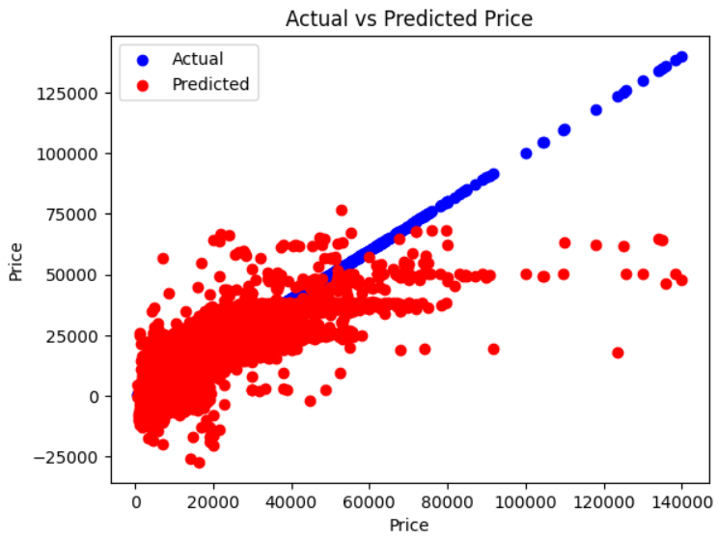
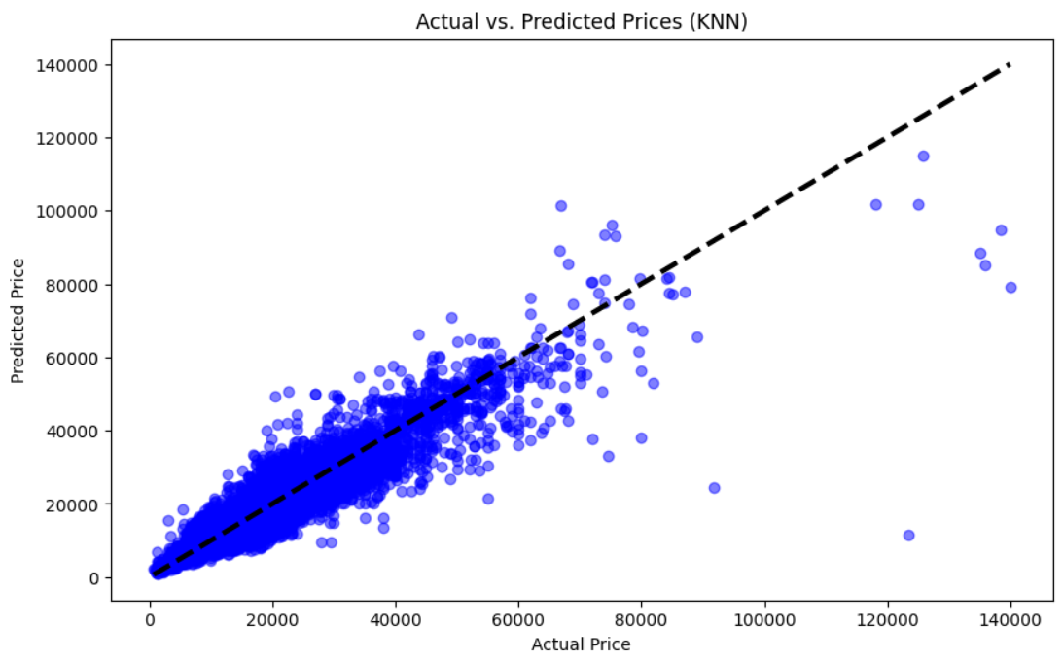
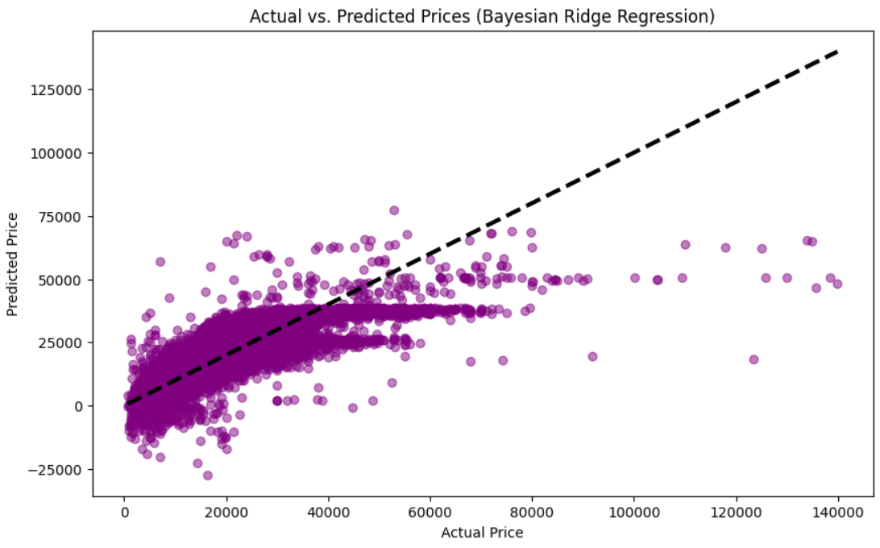
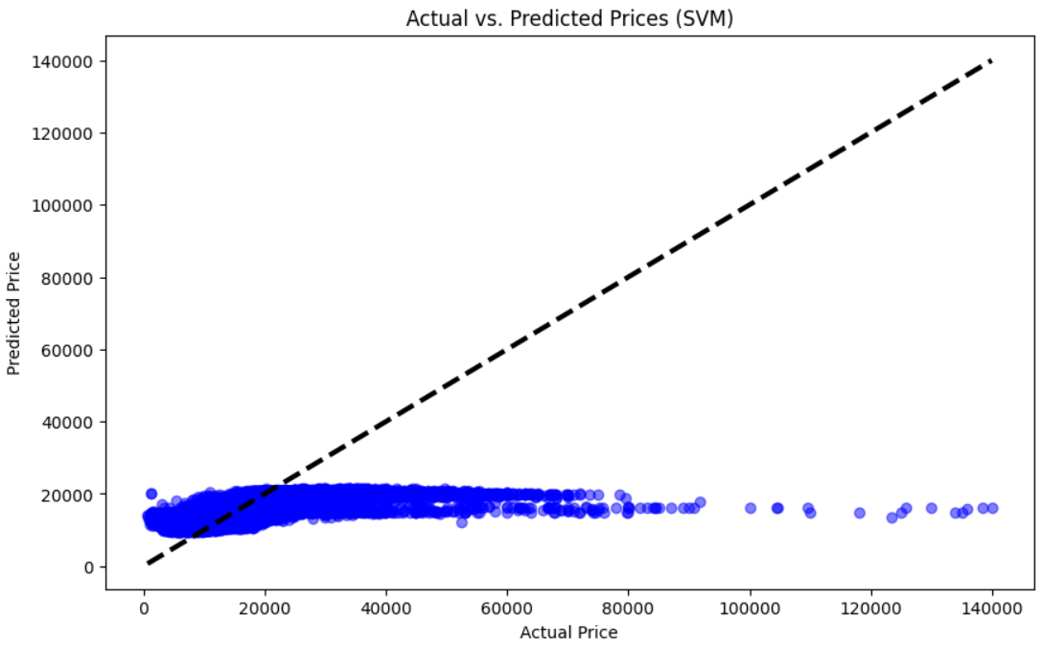
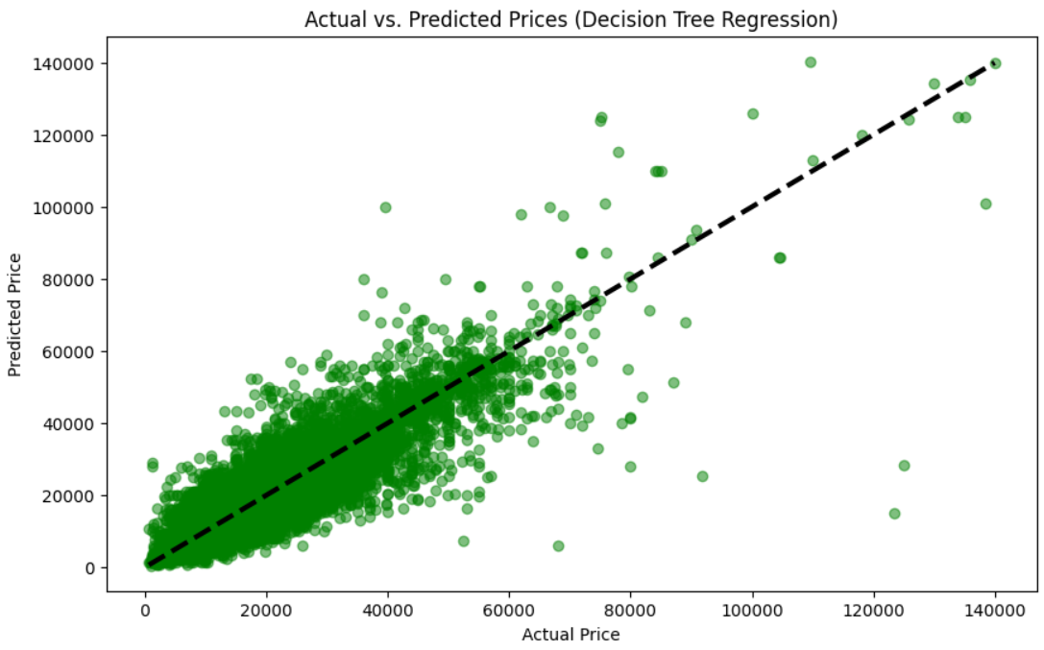
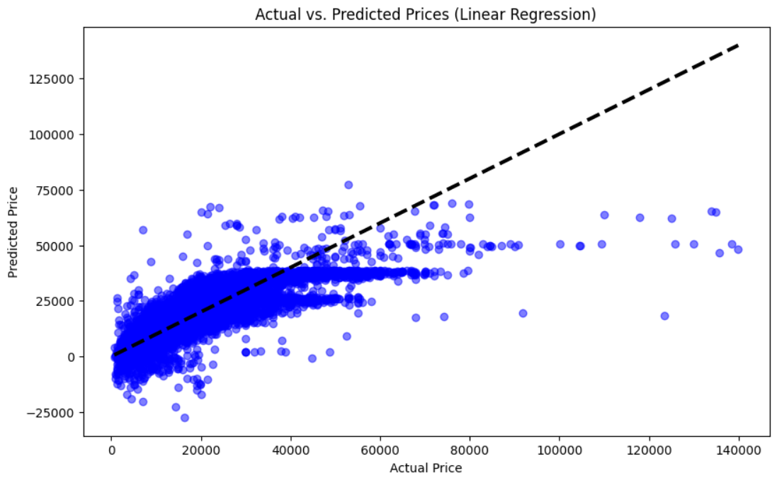
14

Slide 15



Best Performing Model (KNN)
Accuracy
Flexibility
Efficiency
The KNN model achieved the lowest MSE and highest R-squared, outperforming other models.
KNN's ability to capture complex relationships without strong assumptions contributed to its superior performance.
KNN's computational efficiency made it a practical choice for this large-scale dataset.
15

Slide 16
Implications and Future Work
Industry Applications
Future Work
Advanced Techniques
Accurate price prediction can benefit both buyers and sellers in the automobile industry.
Integrating additional data sources, such as economic indicators or consumer reviews, for enhanced accuracy.
Incorporating ensemble methods or neural networks could further enhance predictive accuracy.
16

Slide 17
Thanks!
Any questions?
17

